Slide 1
Open the `my_blog` project

Slide 2
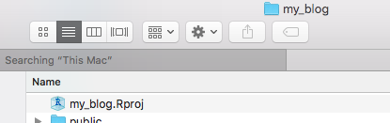

Slide 3
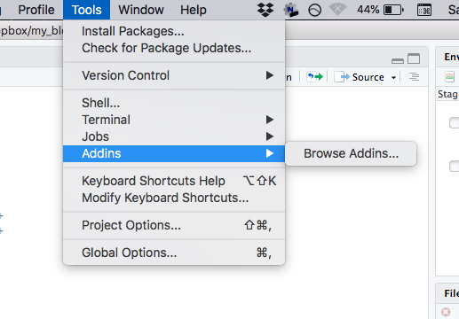

Slide 4
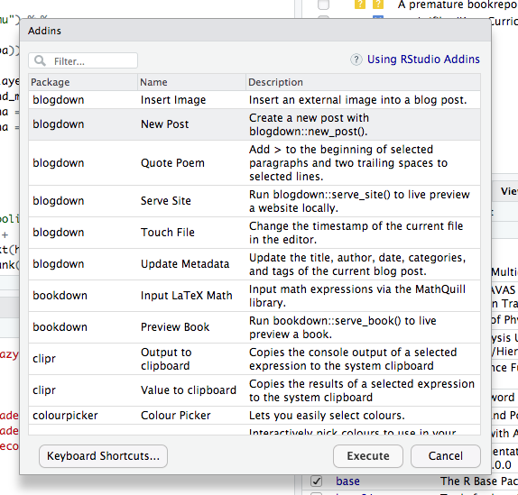

Slide 5
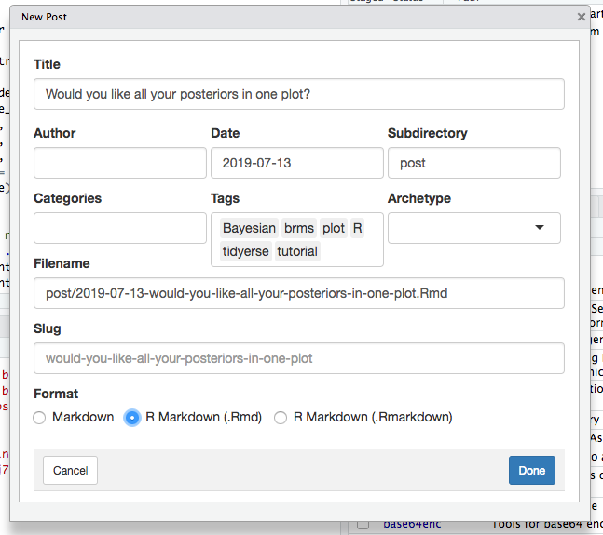

Slide 6
At this point, write the blog to the point you’re ready to review it. Then save: comand + s

Slide 7
The next slide shows how to preview the blog.

Slide 8
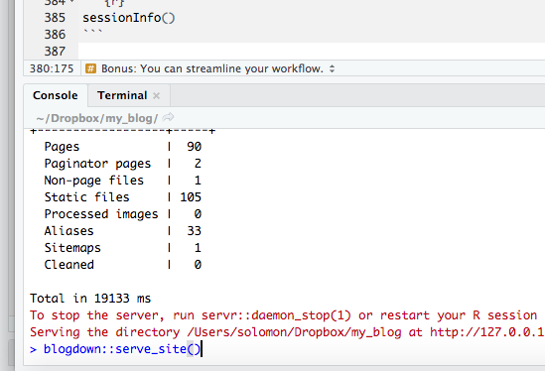

Slide 9
You can iterate back and forth between previewing, editing, saving, and previewing again. Once the post looks good, finalize the post.

Slide 10
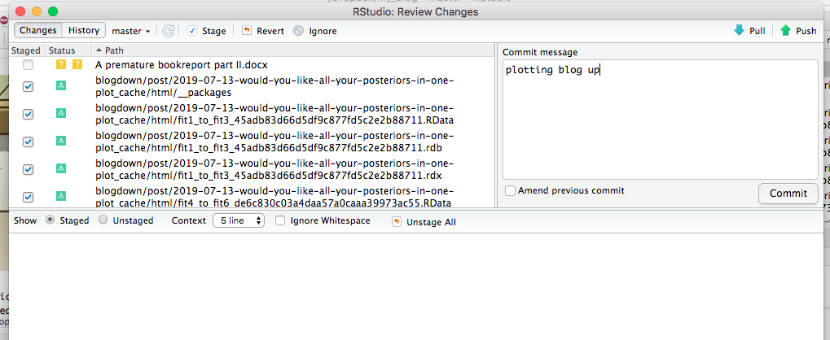

Slide 11
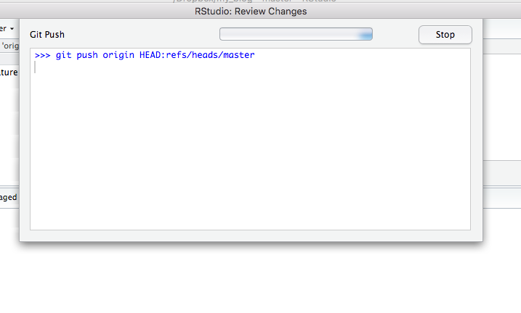

Slide 12
At this point, the post will be live as soon as netlify.com does it’s thing. This will be automatic after committing and pushing.

